Slide 1
FCP for Evaluating Collaborative Filtering Models with Pseudo-Ratings
Camille Bustalinio

Slide 2
Contents
Background
Solution: Collaborative Filtering
Collaborative Filtering Algorithms
Collaborative Filtering Evaluation: RMSE vs MAE vs FCP
Results

Slide 3
Background: Orange Silicon Valley
European Telecommunications Company
Market: Global, mostly Europe and Africa
Headquarters: France (documents in French

Slide 4
Challenge
Situation: Employees in different locations with the same roles
Problem: Different backgrounds, non-standard knowledge
Objective: Personalized course recommendation to complete courses in LMS

Slide 5
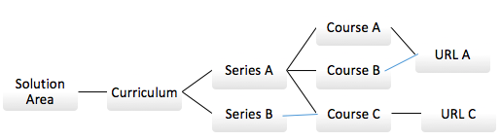
Data: Course Hierarchy
Challenges: Duplicate course ID’s
Why we need it solved: Want only one recommendation
For collaborative filtering, for stronger collaborations
Solution: Cosine Similarities of TF-IDF vectors for course summaries per URL
Result: all URLs are unique, recommend latest course ID

Slide 6
Data: STEP: Course History
Pseudo Rating: Preference for Completed vs In-Progress courses vs Courses Not Taken
Rating Scale:
5: Completed
1: In Progress
0: Not taken (default for Collaborative Filtering)
Note on scale: values on end to maximize scale in predictions

Slide 7
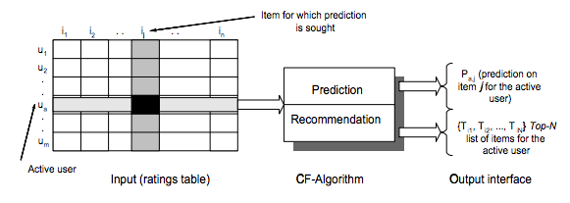
Solution: Collaborative Filtering
User-based – similarities among users to predict item rating

Slide 8


Collaborative Filtering Algorithms: SVD vs SVDpp
SVD
SVD question: which will be completed?
SVDpp: implicit, regardless of score
Rating of 1 treated same way as Rating of 5. Nominal, no rank
SVDpp question: which courses will be taken?

Slide 9
Collaborative Filtering Evaluation: RMSE vs MAE vs FCP Now we have predicted ratings, which is the best model?
Categorical Data: Groups
Nominal – equal groups
Red or white wine?
Ordinal – ranked groups
Waze traffic: Red, Orange or Green traffic flow?
Numeric:
Numbers interpreted in scale:
Temperature
Speed
Volume

Slide 10
In Collaborative Filtering, Ratings are treated as Numeric Data, but they are often ORDINAL
A movie rated 4 isnt “preferred” twice as much as a movie rated 3,
versus a movie rated 2.
Subjective – each user has different baselines
Not-scalable – cannot interpret distances

Slide 11


Evaluation Metrics: RMSE and MAE
RMSE and MAE – smaller is better
common term: RESIDUAL
difference between predicted and actual
Important for numeric, but not for ordinal

Slide 12


Evaluation Metrics: FCP Fraction of Concordant Pairs
where:
n_{c} = Σ_{u}n^{u}_{c} , n_{d} = Σ_{u}n^{u}_{d}
No residuals, just order

Slide 13
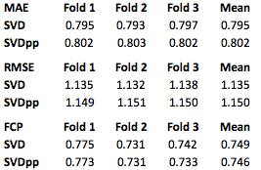
Results: Consistent for best gridsearch models

Slide 14
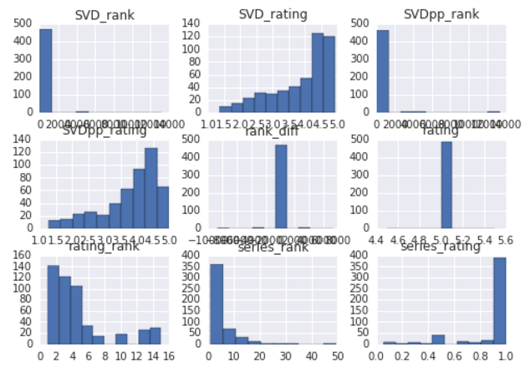
Courses Finished

Slide 15
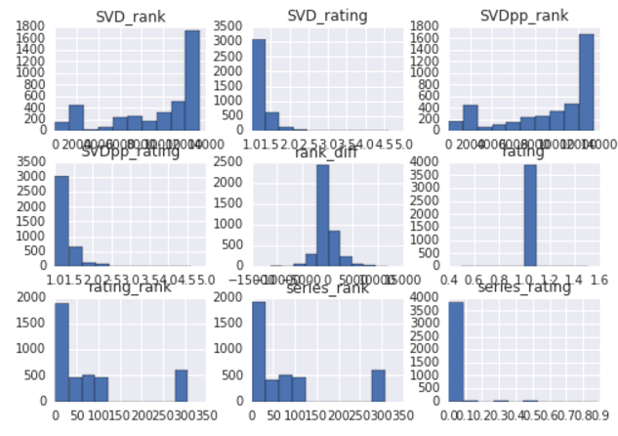
Courses In Progress

Slide 16
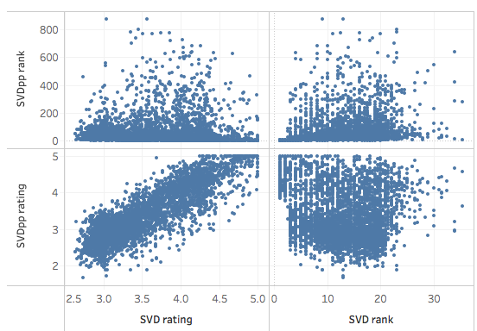
Top 20 Recommended by SVD rating

